Slide 1
CS174 Object Oriented Programming
Professor Ann Marie Schilling

Slide 2
About the Class
This class will further your experience with the Java programming language and introduce you to C++. With C++ you will learn about the lower level aspects of programming languages.
We will also touch on data structures and recursion.

Slide 3
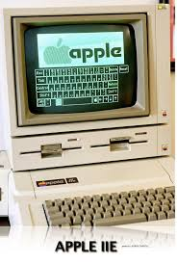
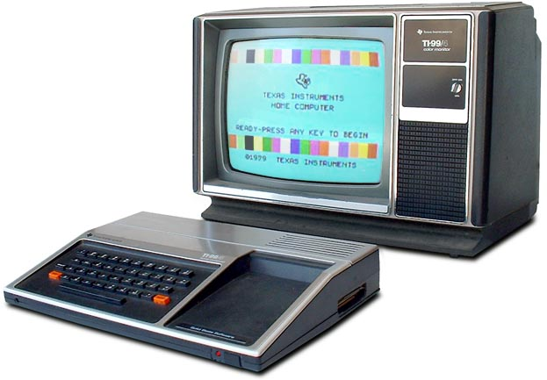
Your Professor
Wrote first program on a TI99/4a hooked up to the family’s TV-set in 1981 ish. Moved on to an Apple][e in HS

Slide 4
Your Professor
BS in Computing Sciences w/ Math and Chemistry minors from University of Scranton
MS in Computing Sciences from Drexel University
Professional Software Engineering experience in Aerospace, Finance, Marketing, Banking
10 years teaching at Drexel
7 years teaching at

Slide 5
The Business of the Class
Syllabus
Schedule
Academic Honesty

